Slide 1
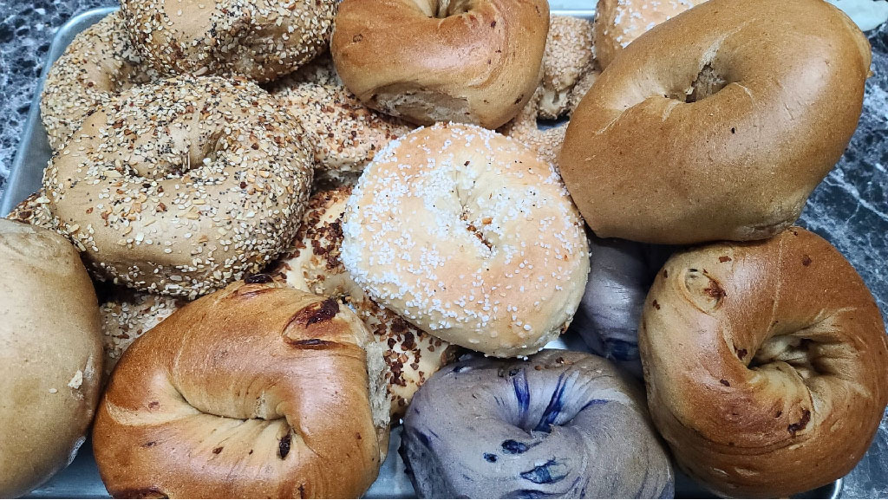
Inwood Bagels
Team 2
Gaelle Giles - Project Manager
Charles Adams - Product Owner
Noah Ponticiello - DBA
Masha Obaturova - Lead Developer
Hemawsi Gorrela - Developer
Nandu Devarasetty - Lead Business Analyst
Abhilash Gubbala - Lead QA Analyst
Brindavani Pathuri - Tester

Slide 2
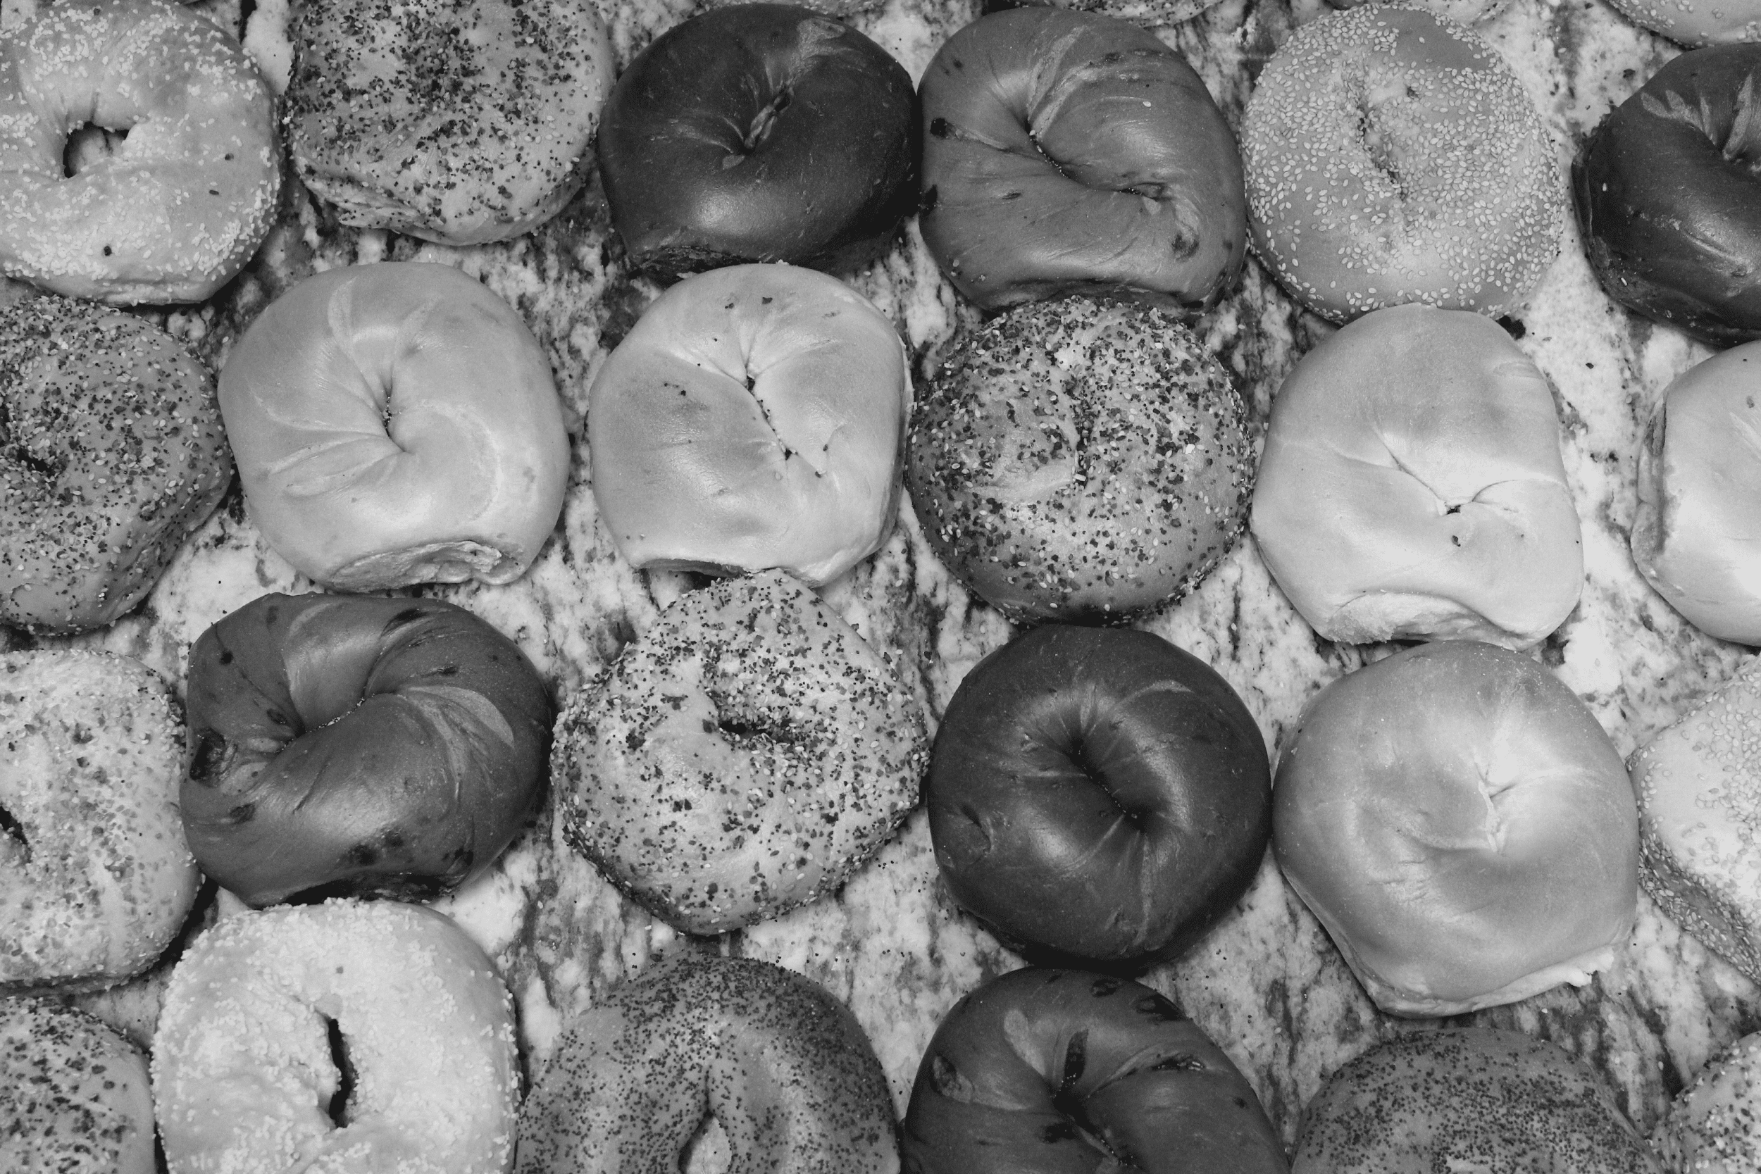
GitHub URL: https://github.com/Team2-Inwood-Bagels

Slide 3
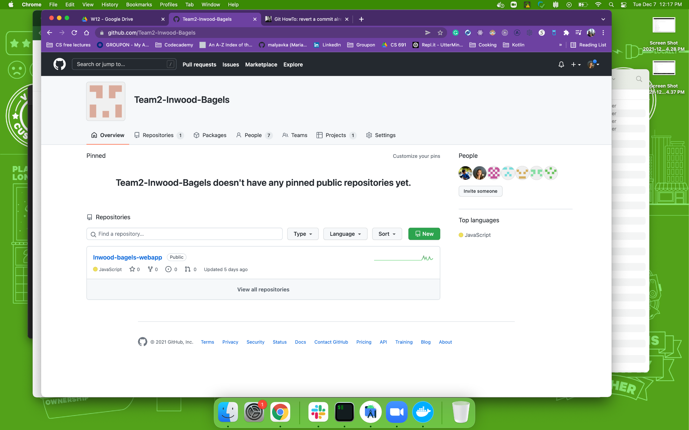
Organization Overview

Slide 4
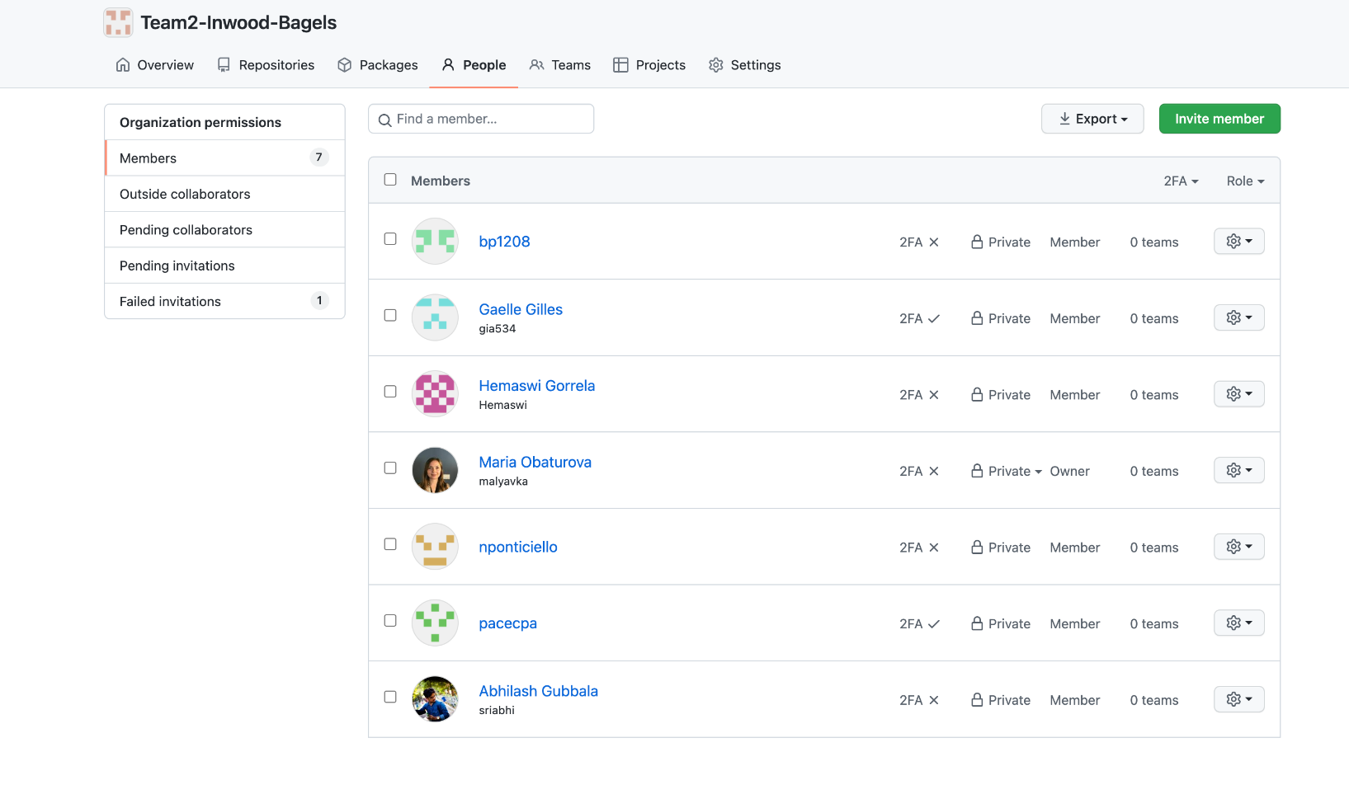
Organization Overview

Slide 5
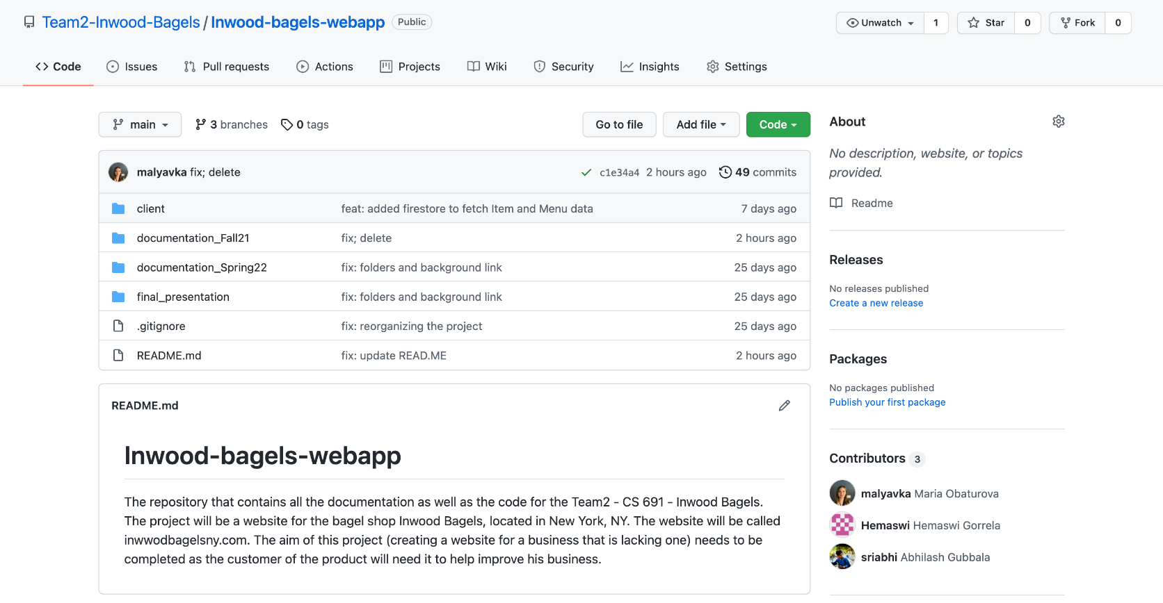
Repository Structure

Slide 6
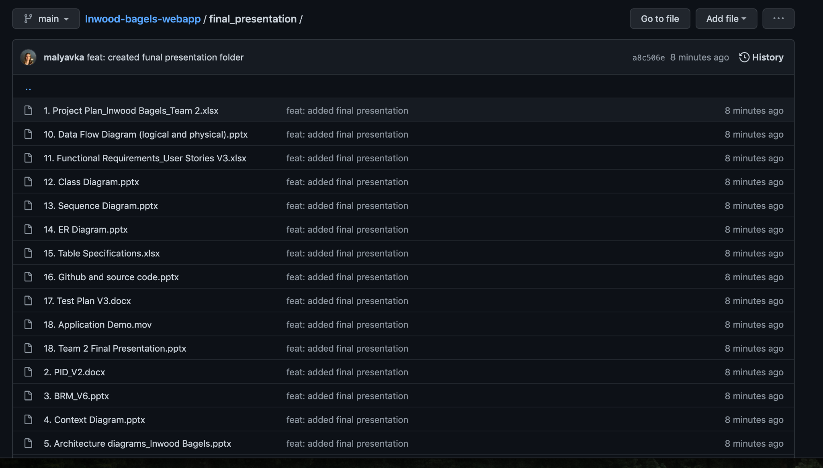
Final Presentation Folder

Slide 7
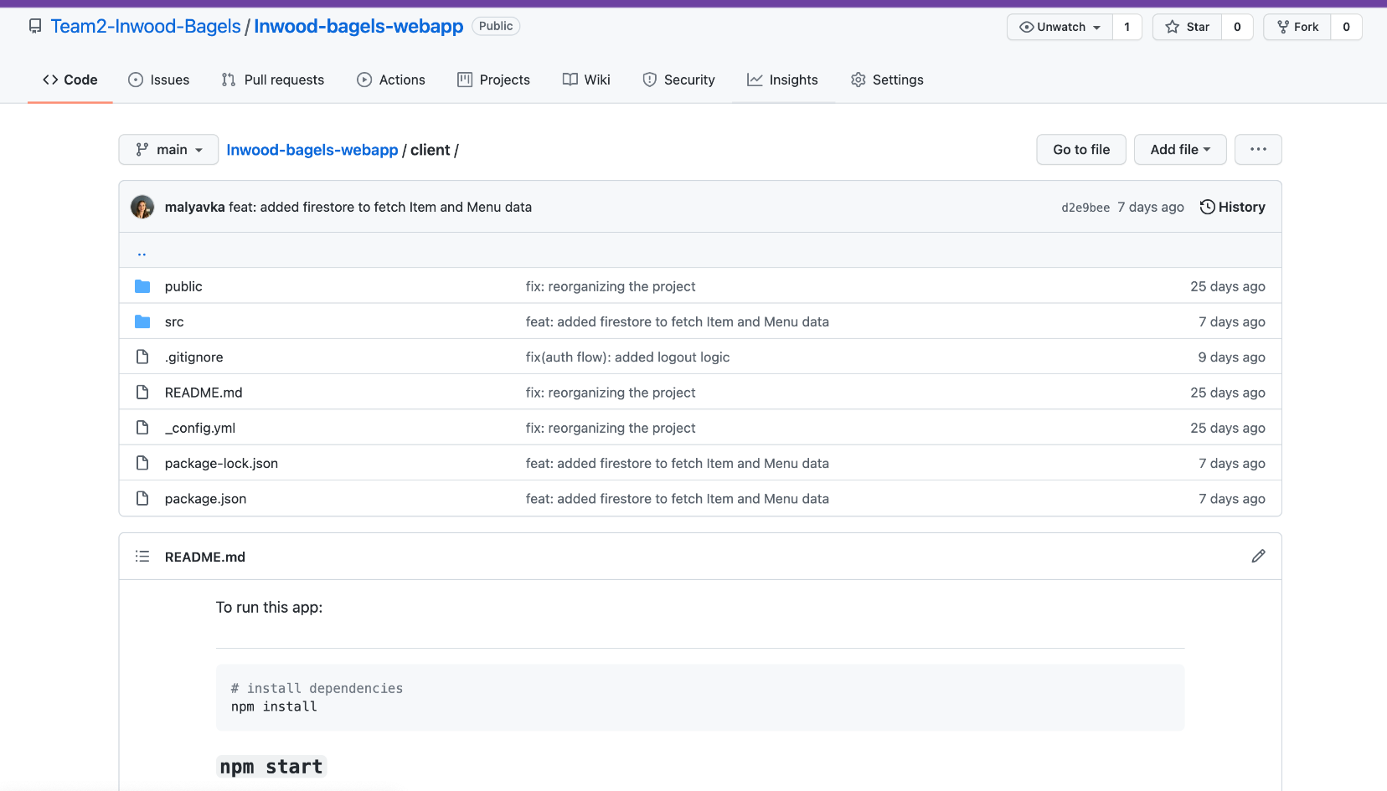
Repository Structure - Client

Slide 8
Build & Run Precedures
Node.js should be installed on the machine
Clone from the GitHUB remote repository
Open the Project in the Text Editor of your choice
Be sure to be in a /Client folder
cd Client
Run npm install in the Terminal window
Run npm start in the Terminal window
Open the browser window and http://localhost:3000/
Important: the configuration file with the API keys and other credentials are not stored in a public GitHUB repo. In order to maintain it, please, reach out to the Lead Developer

Slide 9
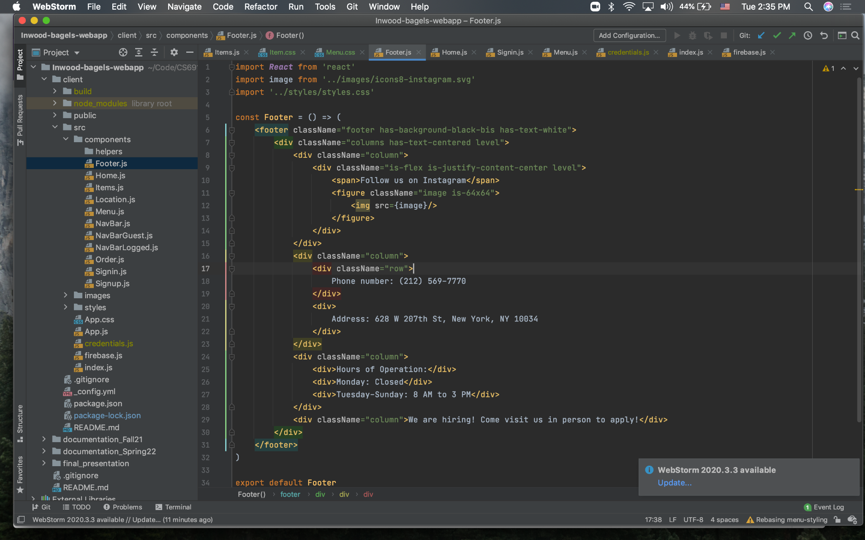
Code Examples

Slide 10
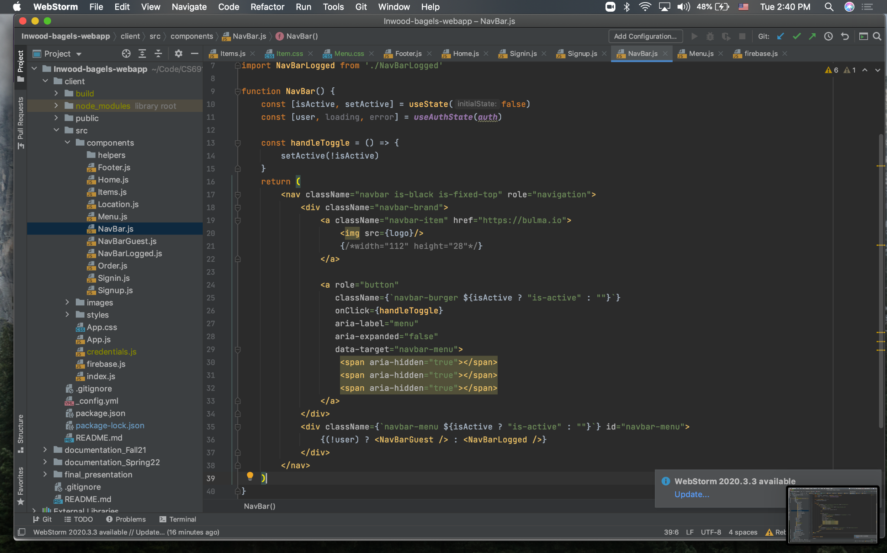
Code Examples

Slide 11
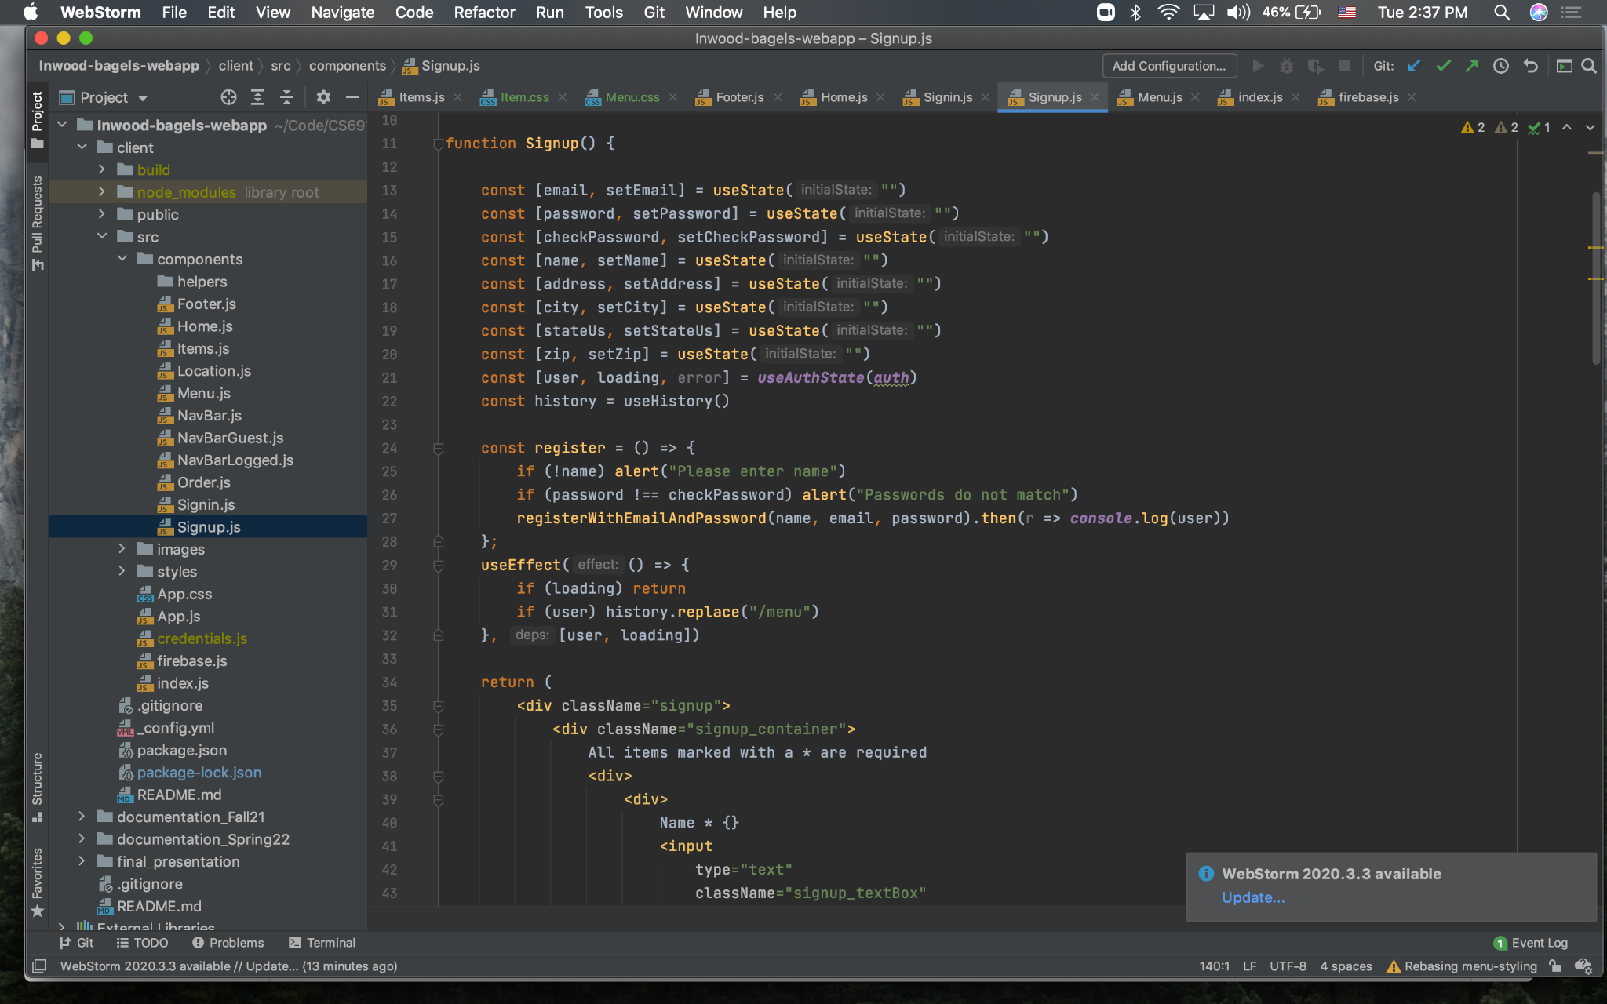
Code Examples

Slide 12
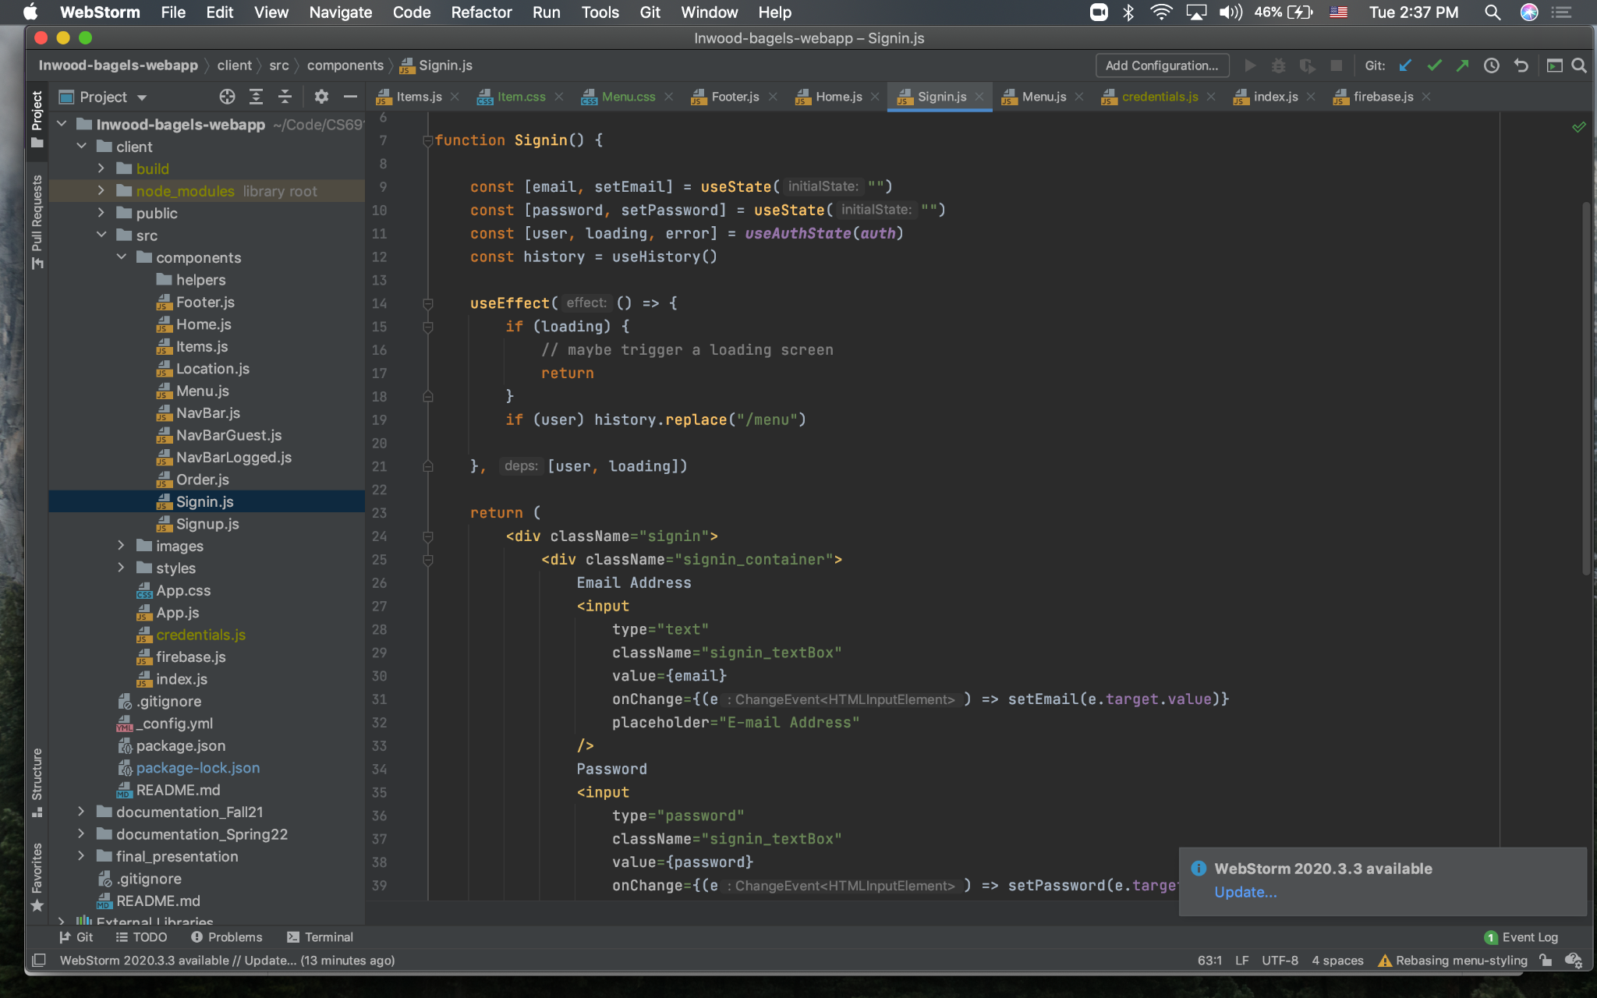
Code Examples

Slide 13
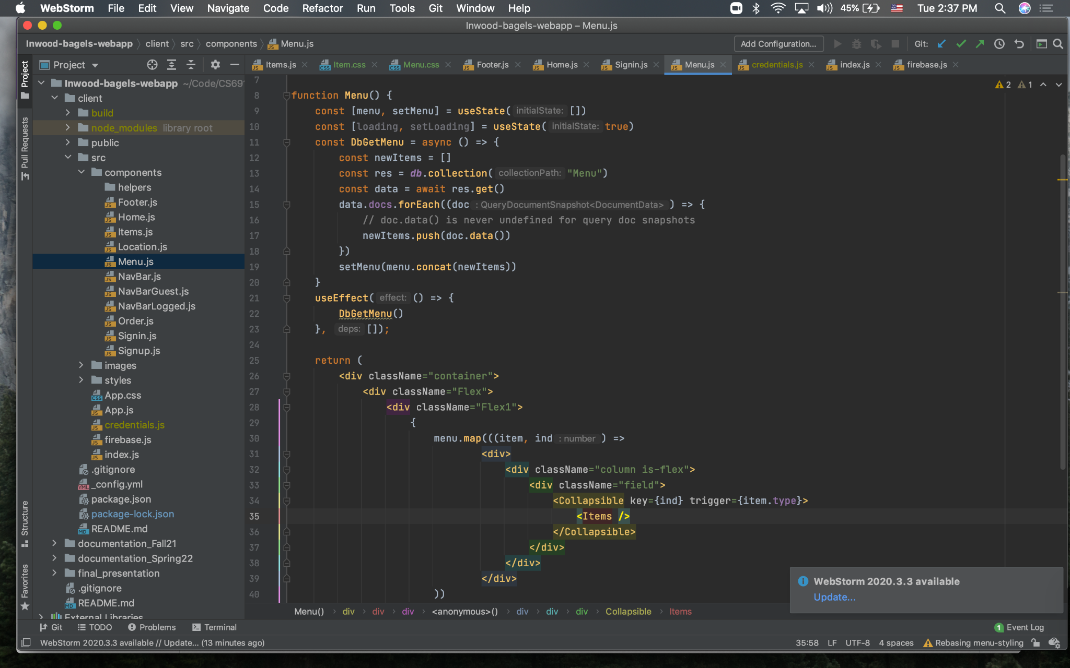
Code Examples

Slide 14
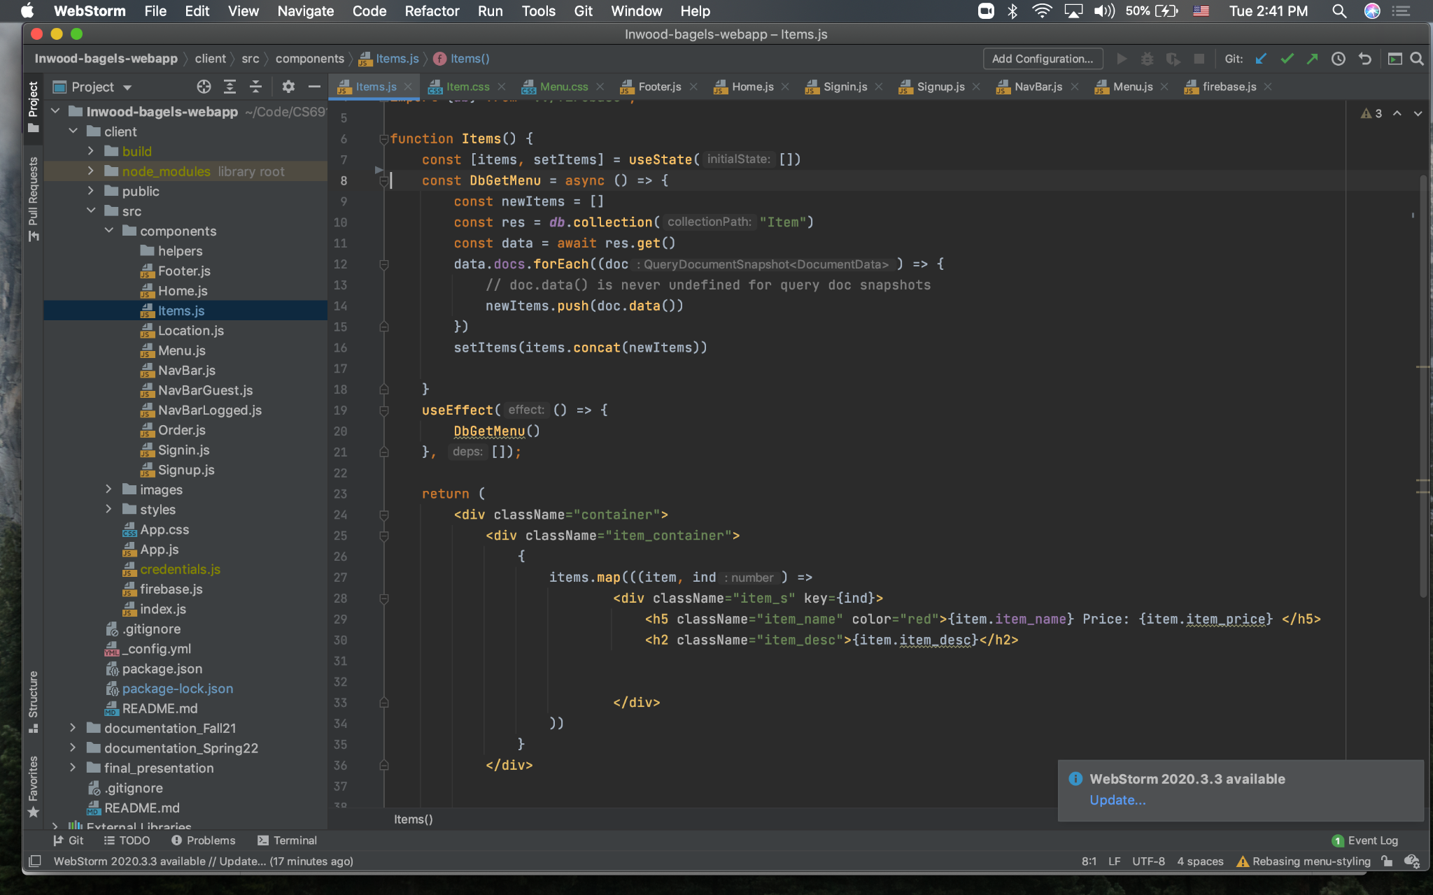
Code Examples

Slide 15
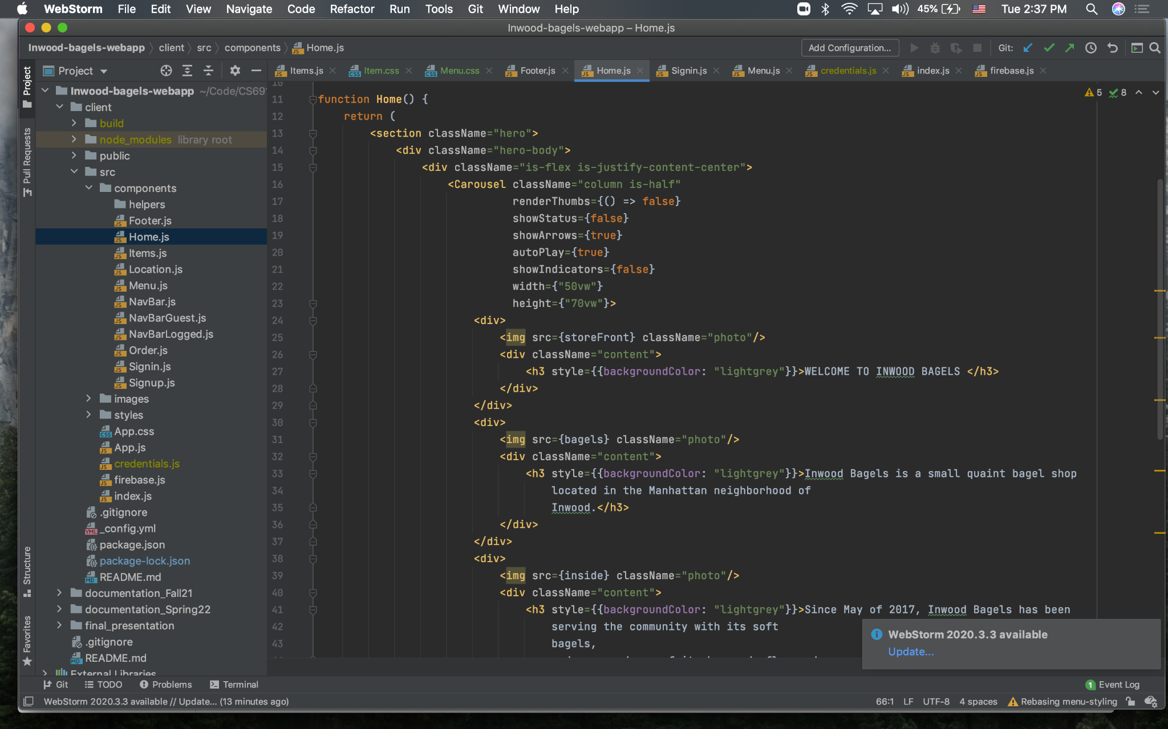
Code Examples

